Slide 1
Sahulat Bazaar
20K -0310 Warda Najam
20K-0390 Robaisha Masood
20K-0266 Noor Afshan

Slide 2
Main concepts of oop used:
Encapsulation
Polymorphism
Inheritance
Friend Class
Filing
Abstract Class + Virtual Function
Template Function
Classes and Objects

Slide 3
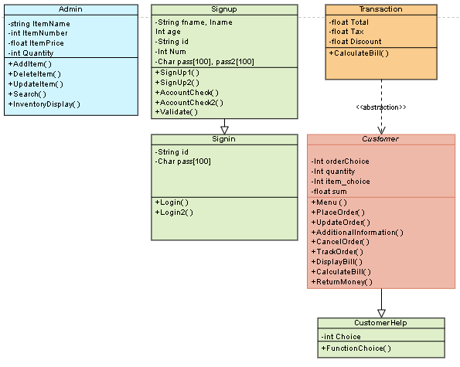
Main Classes

Slide 4
Class
SignUp
Main functions:
account_check()
account_check2()
signup1()
signup2()
validate()
It will help when user is using programme for the first time

Slide 5
Functions
Initial ()
First of all it will ask the user whether they have to login or signup and as soon as they enter their correct choice it will ask whether they have to enter as admin or customer. After that they have to enter the details and it will create the files of both customer and admin:
First name
Last name
User name
Age
Password
Confirm password
Mobile number

Slide 6
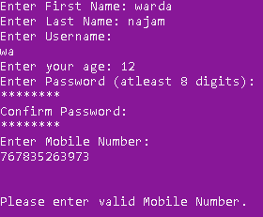
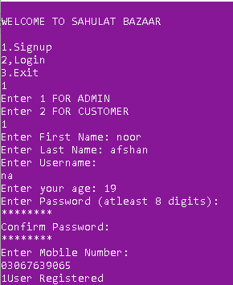
Validate ()
After signing up and entering full details programme will run validation :
Password and confirm password detail should be matched with each other
Age should be greater than 0
Mobile number should contain around 11 digits
If programme found any validation issue it will restart the programme from start

Slide 7
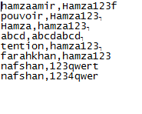
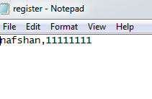
account_check(), account_check2()
After validation is finished, programme will do account check and pass that function to signup function. Account check will only store username and password in the file. Two files will be created one for Admin and the other for Customer.
Register file = Customer
Admin file = Admin

Slide 8
signup1(), signup2()
After file has been made programme will give account_check output to signup function which will compare username and password enter with username and password which is already added. If comparison is not found so it will say “User registered” otherwise it will show “User already exist”.

Slide 10
Class
Login
Main functions:
Initial()
login()
login2()
It will help user to login supermarket

Slide 11
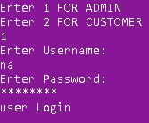
Functions
Initial()
After user has input data and have created account it will again ask whether user who is login in for example are you admin or customer than it will ask for username and password.
login(), login2()
After entering username and password it will compare details with details already entered in file if it matches so it will show “User login” otherwise it will show “user doesn’t exist”

Slide 12
Class
Customer
Main functions:
Initial()
Menu()
PlaceOrder()
UpdateOrder()
AdditionalInformation()
CancelOrder()
TrackOrder()
CalculateBill()
DisplayBill()
MoneyReturn()
It will be providing different services to customer.

Slide 13
Basic Functions
Initial():
After the customer has logged in, he will be shown different options that he can select like:
Place an Order
Update an Order
Cancel Order
Track Order
Exist
Menu():
This function will be called when the customer decides to place an order.
It contains filing. The inventory file will be read and displayed in front of the customer as menu. //reading from file

Slide 14
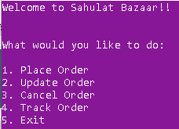
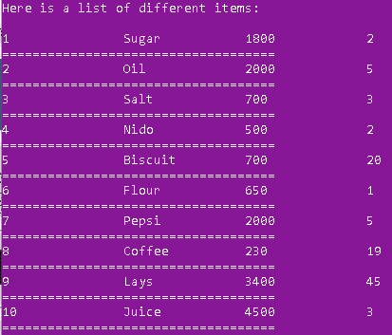
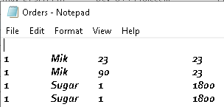

Slide 15
Place Order
The menu function will direct the customer to the PlaceOrder() function.
Here the customer will be asked to enter the product number and quantity of it.
If the product number and quantity exits in the inventory file, he will be proceeded to confirm order.
In this function even after ordering he will have the option to cancel it.
To store all the orders, “Order.txt” will also be made here. //writing in a file

Slide 16
Update Order
This function provides the user to order any remaining stuff.
If the user forgets to choose something in the PlaceOrder() function, he can select this function to add more items.
The new ordered item will also be added in the “Order.txt” file. //append to file
After confirming the order the customer will be directed to AdditionalInformation() function.

Slide 17
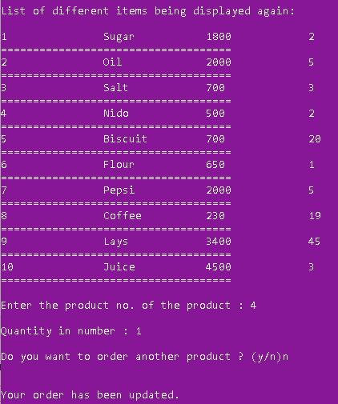
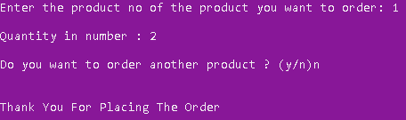
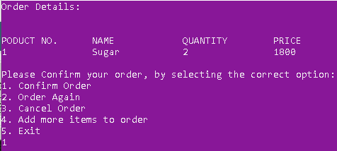

Slide 18
Basic Functions
AdditionalInformation():
This function allows the customer to provide any specific details regarding their order.
It also stores the address of customer using structure.
CancelOrder():
If this function gets called, it cancels the order of the customer and direct him to the main page again.

Slide 19
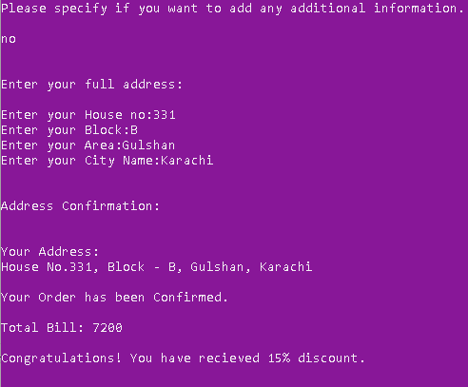
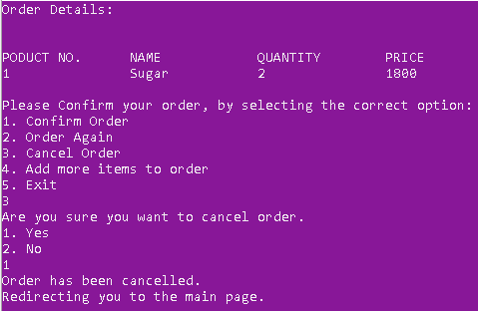
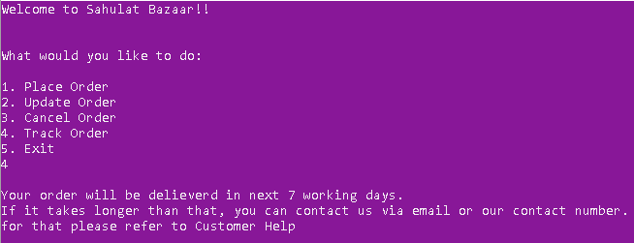

Slide 20
Class
Admin
Main functions:
Admin_menu()
Add_item()
Storeitem()
Delete_item()
Search_item()
Inventory()
Update_item()
It will provide all the basic functions for Admin of the supermarket.

Slide 21
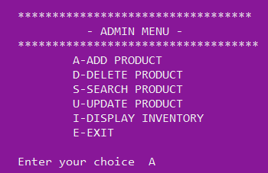
ADMIN MENU
It will display a menu consisting of different options which will ask the user to enter a character according to the function he wants to use.
A switch case will be used to perform this function.

Slide 22
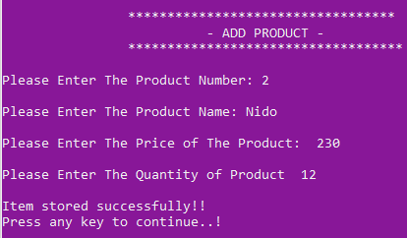
ADD ITEM
When the User will login in as Admin an admin Menu will open from which the user can choose ‘A/a’ to add any new product in the file or inventory.
The add item function will ask the user to enter the details of the product .
The store_item() function will write the details of the item in the file”inventory.dat”.
User can press any key to continue the function will get a character and display the admin menu till user choose to exit.

Slide 23
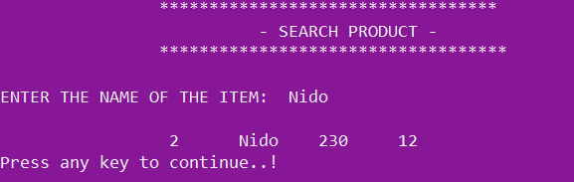
SEARCH ITEM
The Search item will allow the admin/user to search any item present in the file “inventory.dat”.
The function will ask the user to enter the name of the item and it will display the product.

Slide 24
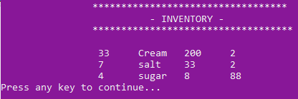
INVENTORY
The inventory will display all the products in the file “inventory.dat” stored by the admin.

Slide 25

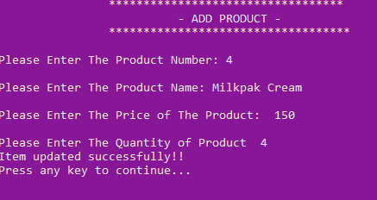
UPDATE ITEM
Update function will help the user to update the details of the product .
It will ask the user to enter name of the product he wan to update .
It will call add_item() to enter the updated details of the product.
Store_item will successfully write item details in the file .

Slide 26
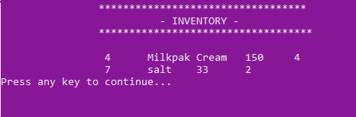
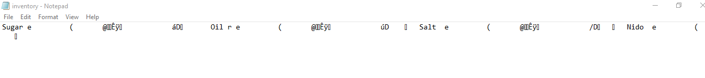
Inventory after Updating the Product
FILE: INVENTORY.DAT

Slide 27
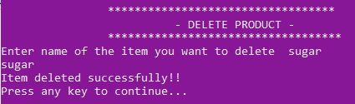
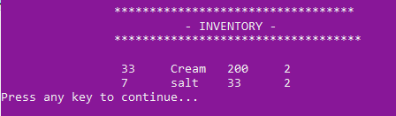
DELETE ITEM
Delete Item will allow the user to delete any item/product from the file .
It will ask the user to enter name of the item he wants to delete.
Then it will prompt a message to the user of successful deletion of the item.
Inventory after Deleting the product

Slide 28
Class
Transaction
Main functions:
Transaction()
virtual float CalculateBill()=0;
It basically calculates the final bill.

Slide 29
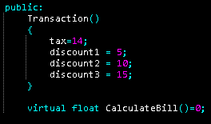
Transaction()
Here Transaction() is the constructor which is being used to initialize the value of different Discounts and Tax.
These initialized variables of the abstract classes are then being used in the concrete class where CalculateBill() is defined.

Slide 30
virtual float CalculateBill()=0
Here we have used the concept of abstract + virtual function.
Transaction is an abstract class while Customer is its concrete class where this function is defined.
Total Bill is calculated and whichever discount is applicable its applied.
Tax is also added here.
The final value is then sent to DisplayBill();

Slide 31
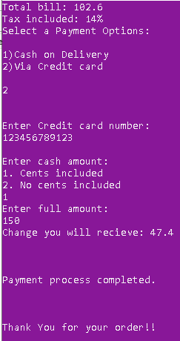
DisplayBill()
This functions accepts and displays one float parameter that is the final bill after adding discounts and tax.
We have provided the customer with two different Payment options:
Cash on delivery
Credit Card
The cash customer pays will be sent to MoneyReturn() function to check if any change is need to be given.

Slide 32
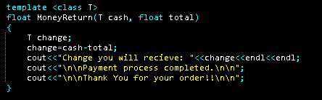
MoneyReturn()
Here we have used the concept of Template Function.
The amount given by the customer can have cents or cannot so it this function calculates for both int and float value.
It then returns the change to DisplayBill().
After displaying that, the program ends.

Slide 33
CLASS CUSTOMER HELP
It will help to direct the customer to different functions.
Customer help will display a menu which will consist of all the functions for the Customer.
It is basically the derived class of Customer.
It has an additional feature of Track_order.
Hi! How can we help?

Slide 34
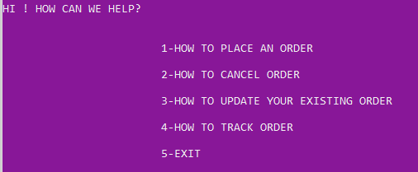
The user will choose the right option and he will be directed to the particular function.

Slide 35
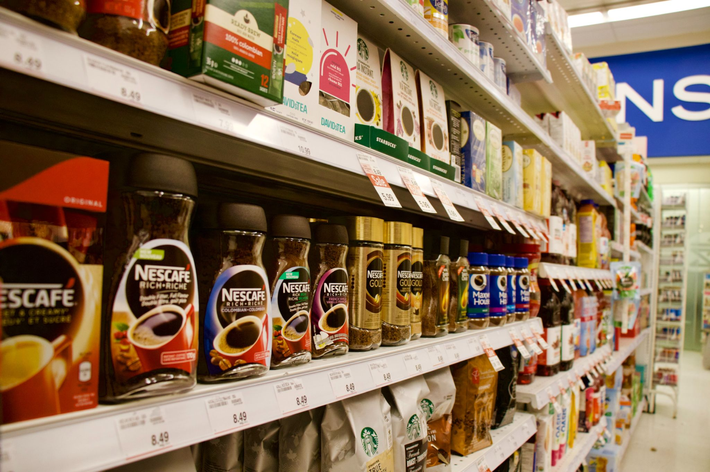
Thanks!
Contact us:
Sahulat Bazar
Email:
sahulat_bazar@gmail.com

